Slide 1
Object Oriented Programming
Programming Paradigm using Python

Slide 2
1
Introduction to OOPS
Methods
4
1. What is OOPS
2. Why OOPS
3. Creating Simple OOPS Code
Calling Methods
Non-Public Methods
Methods & Return Statements
BEPEC CT
OOPS Agenda
2
What is Class & Object?
Aggregation
5
Aggregation vs Composition
“is” Operator
Aliasing, Mutability & Cloning
What is Instance, Instance Attribute
Access the Instance Attribute & Update it
What is Class Attribute?
3
Encapsulation & Abstraction
Inheritance
6
Using Super
Types of Inheritance
Overloading & Overriding
Polymorphism
Public & Non-Public Attributes
Name Mangling
Getter & Setter Commands

Slide 3
What is OOPS?
Object Oriented Programming is a programming paradigm based on the concept of Objects, which can contain data(attributes) and code(methods)
Programming paradigms are different ways or styles in which a given program or programming language can be organized. Each paradigm consists of certain structures, features, and opinions about how common programming problems should be tackled.

Slide 4
What is OOPS?
Object Oriented Programming is a programming paradigm based on the concept of Objects, which can contain data(attributes) and code(methods)
Programming paradigms are different ways or styles in which a given program or programming language can be organized. Each paradigm consists of certain structures, features, and opinions about how common programming problems should be tackled.

Slide 5
Types of Programming Paradigm?
?
Imperative Programming
Procedural Programming
Functional Programming
Declarative Programming

Slide 6
Types of Programming Paradigm?
Encapsulation
Abstraction
Inheritance
Polymorphism

Slide 7
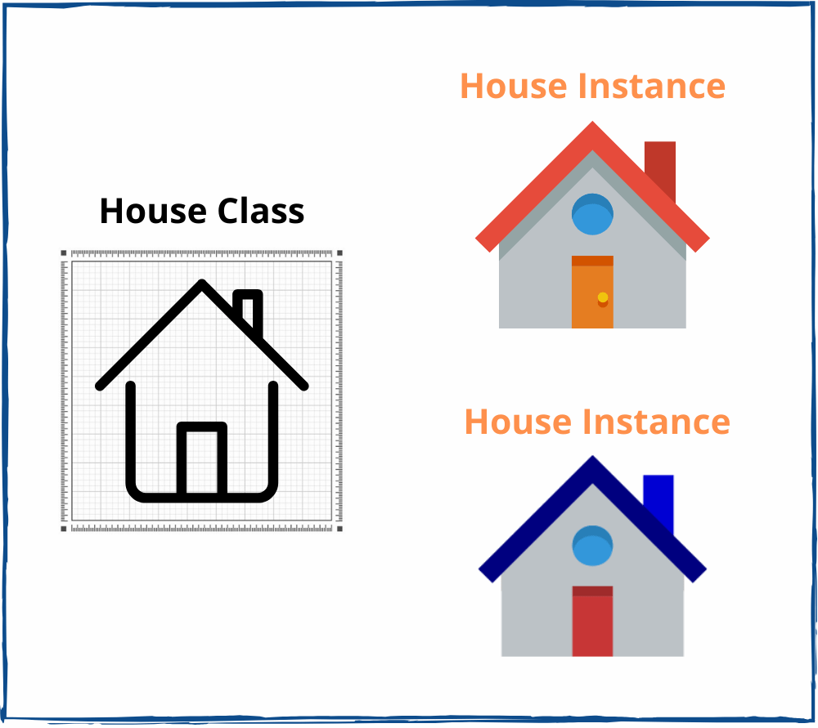
What is Class & Object
State & Behavior
State & Behavior

Slide 8
Advantages of OOPS
Reusability
Extensibility
Modularity

Slide 9

Advantages of OOPS

Slide 10
Class Naming Convention
For Class Names we use Pascal Case/Upper Camel Case as the Naming Convention.
First Letter of each word is capitalised
Example: BmiCalculator

Slide 11
Instance
Instance is an Object Created from Class
Class = Abstract, Instance = Concrete
Concrete
Abstract

Slide 12
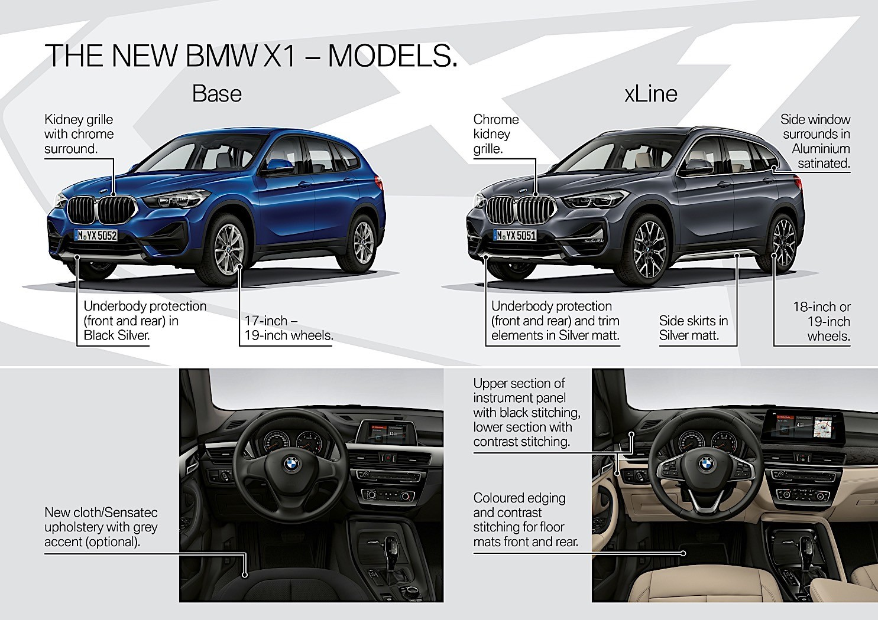
Instance Attributes
The Attributes of an Object, They belong to a particular object

Slide 13
__init__()
Special Method used to define the initial state of the object
We need to call it when we create an Instance

Slide 14

Self
Self is a generic way of referring to the current instance of the class
Of the instance that being created
To the instance attribute “name”
Assign the value to the variable

